Slide 1
2023-02-13

Slide 2
Warm up
Sample test questions

Slide 3
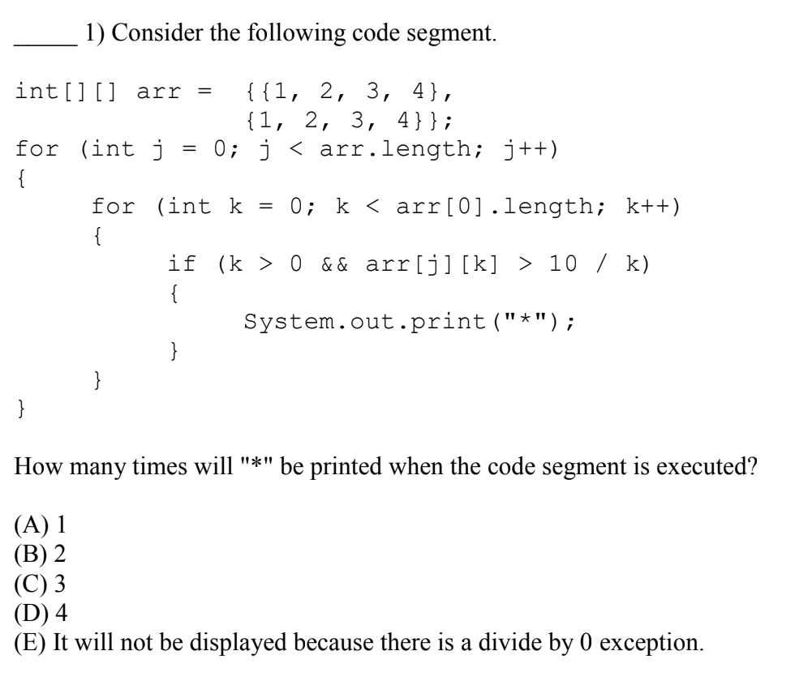

Slide 4
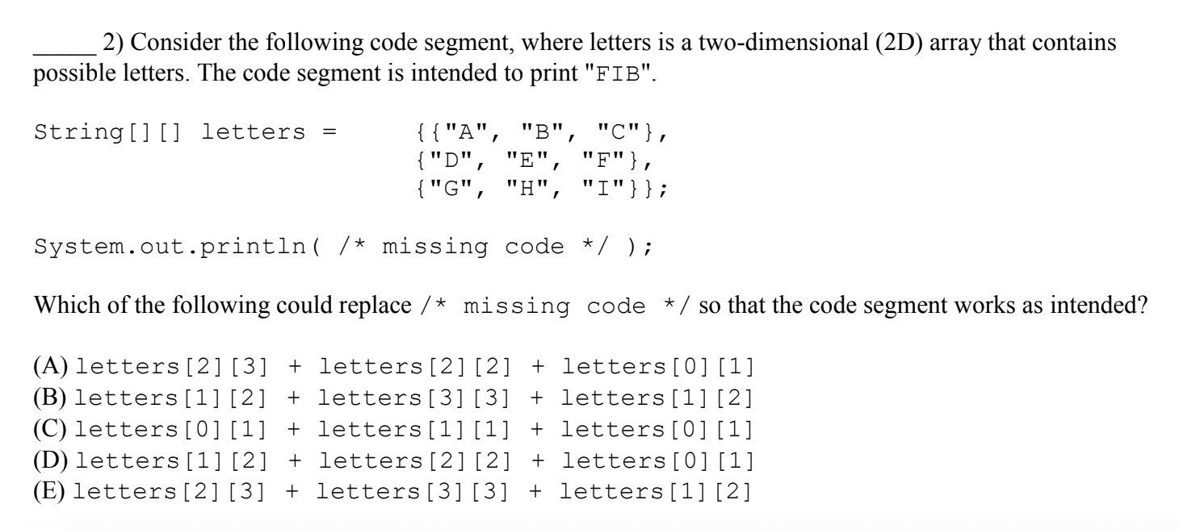

Slide 5
8.1
Two-Dimensional Arrays

Slide 6
Arrays
0
1
2
Arrays are a zero-based indexed sequence of values of the same type. Any Java type! (Well, not void. But all other primitive or reference types.)
type[] name;
Examples:
boolean[] answers; String[] questions; int[] scores; Student[] students;
v
v
v

Slide 7
Array of Arrays
0
1
2
Arrays are a type, too. So, an array can be declared with arrays as its values. The result? Two-dimensional arrays!
type[][] name;
Examples:
boolean[][] theaterSeats; String[][] seatingChart; int[][] bingoCard; Apt[][] building;
v
v
v
v
v
v
v
v
v

Slide 8

2D Arrays
In Java, a two-dimensional array is really a one-dimensional array of one-dimensional arrays.
Conceptually, though, such arrays are used to model two-dimensional concepts, and we think of it as a single table with rows and columns.
At the Java level, it's actually an outer array where each element is a reference to a nested inner array.

Slide 9
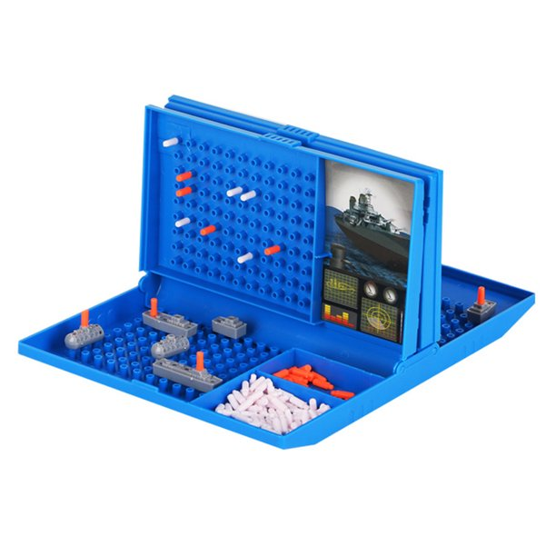


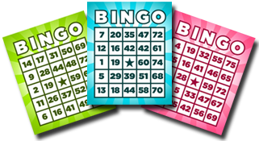
What are 2D arrays good for?

Slide 10
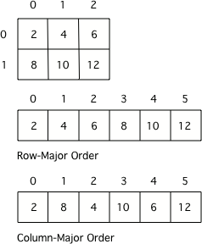
Array Storage
Many programming languages actually store two-dimensional array data in a one-dimensional array.
row-major order
column-major order
In C/C++, for instance, you can declare
int a[3][3];
and under the hood, the C compiler will make a one-dimensional array A' that is size 9, and compile a[i][j] to A'[i*3 + j]
The frame buffer that stores the pixels on your screen is obviously 2D, but is probably stored in a one-dimensional array referenced by frameBuffer[y * screenWidth + x]
The Java language designers made a decision to model multi-dimensional arrays as arrays of arrays. (Python: Same.)

Slide 11
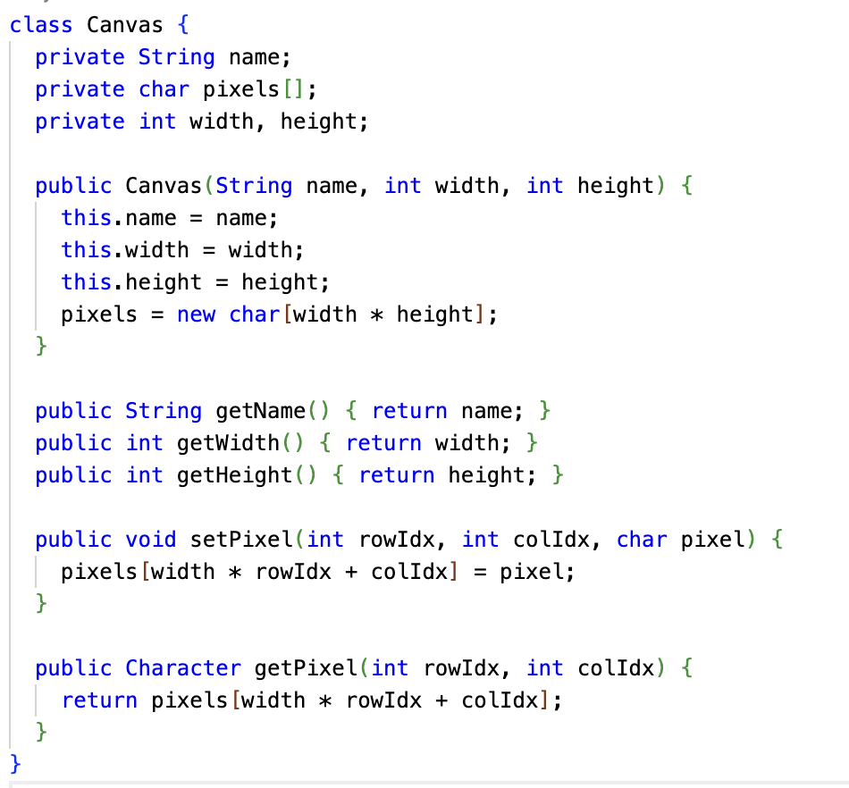
For the ASCII Art exercise, it is possible to implement the Canvas using a one-dimensional array in row or column major order.
In some respects, this is more efficient, as it's one contiguous object in memory.
Accessing the elements is more complicated, so the accessor/mutator methods become more important!

Slide 12
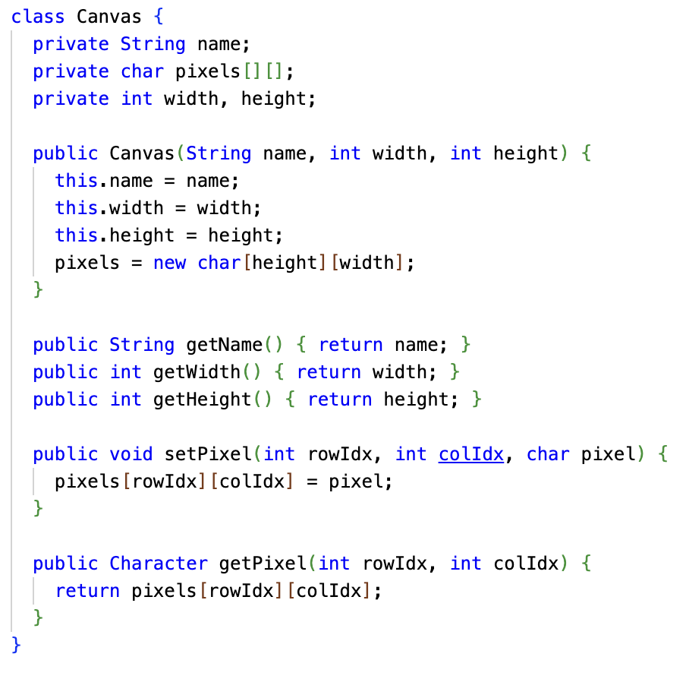
Here's the more conventional 2D array approach to the ASCII Art Canvas.
Is pixels in row-major or column-major order here?

Slide 13
Array types of array types
Object
Object[]
Every type T in Java has a related array type T[]
Examples: int and int[], String and String[]
But... this is ALSO true for array types themselves!
T[] has a related array type T[][]
T[][] is an array of T[]
type[][] name;
Examples
boolean[][] theaterSeats; <- array of boolean[] String[][] seatingChart; <- array of String[] int[][] bingoCard; <- array of int[] Apt[][] building; <- array of Apt[]
String
String

Slide 14
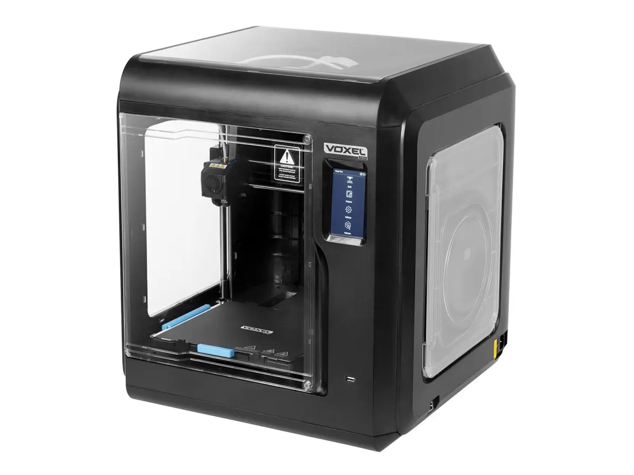
Multi-Dimensional Arrays
You don't have to stop at two dimensions...
The type T[][][] is an array of T[][]
Example: A 3D printer prints "voxels", three-dimensional pixels. Software for a 3D printer might store a model in memory in a 3-dimensional array.
Voxel[][][] voxels;
A Minecraft-like game might store an animation as frames of 3D voxels, but over time. So, a 4-dimensional array:
Voxel[][][][] voxelAnimationFrames;
Two-dimensional arrays are the most common multi-dimensional arrays, though.

Slide 15
Array of Arrays - Definition
boolean[][] theaterSeats = new boolean[numRows][numSeatsPerRow];
String[][] seatingChart = new String[numRows][numSeatsPerRow];
int[][] bingoCard = new int[5][5];
Apt[][] building = new Apt[numFloors][numAptsPerFloor];
* NOTE 1 *
Two-Dimensional Arrays can have non-equal dimensions!
boolean[][] theaterSeats = new boolean[75][25];
String[][] seatingChart = new String[5][10];
int[][] multiplicationTable = new int[100][500];
Apt[][] building = new Apt[5][10];

Slide 16
Array of Arrays - Definition
boolean[][] theaterSeats = new boolean[numRows][numSeatsPerRow];
String[][] seatingChart = new String[numRows][numSeatsPerRow];
int[][] bingoCard = new int[5][5];
Apt[][] building = new Apt[numFloors][numAptsPerFloor];
* NOTE 2 *
Just like Arrays - Two-Dimensional Arrays initialize their values to "reasonable" defaults
0 for numeric types null for Object types false for boolean types

Slide 17
Array of Arrays - Definition
int[][] bingoCard = new int[5][5]; Alternatively... int[][] bingoCard = new int[5][]; // omit internal array size bingoCard[0] = new int[5]; bingoCard[1] = new int[5]; bingoCard[2] = new int[5]; bingoCard[3] = new int[5]; bingoCard[4] = new int[5];

Slide 18
Array of Arrays - Definition
boolean[][] theaterSeats = new boolean[numRows][numSeatsPerRow]; Alternatively... boolean[][] theaterSeats = new boolean[numRows][]; for (int rowIdx = 0 ; rowIdx < numRows ; rowIdx++ { theaterSeats[rowIdx] = new boolean[numSeatsPerRow]; }

Slide 19
Arrays of Arrays - Example
boolean[][] theaterSeats = new boolean[row][seats];
theaterSeats[0]
theaterSeats[0][0]
theaterSeats[0][...]
theaterSeats[0][seats-1]
false
false
false
theaterSeats[...]
theaterSeats[...][0]
theaterSeats[...][...]
theaterSeats[...][seats-1]
false
false
false
theaterSeats[rows-1]
theaterSeats[rows-1][0]
theaterSeats[rows-1][...]
theaterSeats[rows-1][seats-1]
false
false
false
Write: theaterSeats[0][0] = true; Read : System.out.println(theaterSeats[rows-1][seats-1]);

Slide 20
Arrays of Arrays - Initializer Lists
You can initialize the values of a Two-Dimensional Array when you create it (and the sizes will be automatically calculated)
int[][] ticketInfo = { {25,20,25}, {25,20,25} }; ticketInfo.length => 2 ticketInfo[0].length) => 3 ticketInfo[1].length) => 3
boolean[][] jaggedTable = { {false, true, true}, {false}, {true} }; jaggedTable.length => 3 jaggedTable[0].length) => 3 jaggedTable[1].length) => 1 jaggedTable[2].length) => 1

Slide 21
Arrays of Arrays - Jagged Arrays
On the exam all inner arrays will have the same length - However it is possible in Java to have inner arrays of different lengths. These are called Jagged (or Ragged) Arrays
int jaggedTable[][] = new int[3][]; // omit the inner array size jaggedTable[0] = new int[6]; jaggedTable[1] = new int[2]; jaggedTable[2] = new int[5];
jaggedTable.length => 3 jaggedTable[0].length => 5 jaggedTable[1].length => 10 jaggedTable[2].length => 20

Slide 22
8.2
Traversing
Two-Dimensional Arrays

Slide 23


Review: Traversing Arrays with for loops
Remember that the range of valid Array indexes (for non-empty Arrays) is 0 to Array.length - 1
int scores[] = {95, 100, 91, 85 };
for (int idx = 0; idx < scores.length; idx++) {
System.out.println(scores[idx]);
}
int scores[] = {95, 100, 91, 85 };
for (int idx = 1; idx <= scores.length; idx++) {
System.out.println(scores[idx]);
}

Slide 24
Review: Traversing Arrays with for loops
Remember that the range of valid Array indexes (for non-empty Arrays) is 0 to Array.length - 1
int scores[] = {95, 100, 91, 85 };
for (int idx = 0; idx < scores.length; idx++) {
System.out.println(scores[idx]);
}
int scores[] = {95, 100, 91, 85 };
for (int idx = 1; idx <= scores.length; idx++) {
System.out.println(scores[idx]);
}
Note: Passing an out of range index will cause a ArrayIndexOutOfBoundsException!

Slide 25
Review: Traversing Arrays with for loops
Remember that the range of valid Array indexes (for non-empty Arrays) is 0 to Array.length - 1
int scores[] = {95, 100, 91, 85 };
for (int idx = 0; idx < scores.length; idx++) {
System.out.println(scores[idx]);
}
This loop also skips the first element in the Array!
int scores[] = {95, 100, 91, 85 };
for (int idx = 1; idx <= scores.length; idx++) {
System.out.println(scores[idx]);
}
Note: Passing an out of range index will cause a ArrayIndexOutOfBoundsException!

Slide 26
Review: Traversing Arrays with for loops
You can use a for loop to traverse an Array from back to front!
int scores[] = {95, 100, 91, 85 };
for (int idx = scores.length - 1; idx >= 0; idx--) {
System.out.println(scores[idx]);
}
...or to traverse any arbitrary range of elements
int scores[] = {95, 100, 91, 85 };
for (int idx = 1; idx <= 2; idx++) {
System.out.println(scores[idx]);
}

Slide 27
Traversing Two-Dimensional Arrays with for loops
Traversing Two-Dimensional Arrays is very similar
int scores[ ][ ] = { {10,20,30},{40,50,60} };
for (int idx = 0; idx < scores.length; idx++) { for (int jdx = 0; jdx < scores[idx].length; jdx++) {
System.out.println(scores[idx][jdx]); }
}
Typically start at index = 0
& don't exceed length-1
Note: Passing an out of range index will cause a ArrayIndexOutOfBoundsException!

Slide 28
Review: Traversing Arrays with for-each loops
for (type arrayItemVariable : arrayVariable) { arrayItemVariable resolves to arrayVariable[...] }
String[] colors = {"red", "orange", "purple"}; System.out.println("begin"); for(String color: colors){ System.out.println(" " + color); } System.out.println("end");

Slide 29
Review: Traversing Arrays with for-each loops
The type of the for-each variable MUST match the type of the values stored in the Array
String colors[] = {"red", "orange", "purple"}; for(int color: colors){ System.out.println(" " + color); }
Note: color must be of type String since colors is an Array that contains Strings

Slide 30
Traversing Two-Dimensional Arrays with for-each loops
Remember during the introduction of Two-Dimensional Arrays - We said: "Arrays are a type - Which means you can easily create an Array that contains Arrays - often called Two-Dimensional Arrays"
That means we can use for-each to traverse a Two-Dimensional Array almost exactly like a One-Dimensional Array (we just have to be careful how we declare the types)
Reminder: for-each loops can be super-useful; but you are unable to make use of an index or change the underlying Array while looping

Slide 31
Traversing Two-Dimensional Arrays with for-each loops
Given this Two-Dimensional Array
int scores[][] = {{10,20,30},{40,50,60}};
And this general description of for-each
for (type arrayItemVariable : arrayVariable) { arrayItemVariable resolves to Array[...] }
Q: What is the type of the outer array in scores?
scores[] -> an array of int[]
Q: What is the type of the inner array in scores?
scores[][] -> an array of int

Slide 32
Traversing Two-Dimensional Arrays with for-each loops
int scores[][] = {{10,20,30},{40,50,60}};
scores[] -> an array of int[] scores[][] -> an array of int
So we can use for-each to traverse the Two-Dimensional Array like this
for (int[] outer : scores) {
for (int inner : outer) {
System.out.println(inner);
} }
Note: The inner array is a One-Dimensional Array - So we use the same for-each that we used previously for One-Dimensional Arrays
for (type arrayItemVariable : arrayVariable) { arrayItemVariable resolves to arrayVariable[...] }
No indices available for use!

Slide 33
Traversal of Jagged Arrays
Traversal of Two-Dimensional Jagged Arrays works the same!
int jaggedTable[][] = new int[3][]; jaggedTable[0] = new int[]{4,1,5,9,6,3}; jaggedTable[1] = new int[]{9,1}; jaggedTable[2] = new int[]{0,3,2,9,4}; for (int idx = 0; idx < jaggedTable.length; idx++) { for (int jdx = 0; jdx < jaggedTable[idx].length; jdx++) { System.out.print(jaggedTable[idx][jdx] + " "); } System.out.println(); }
4
1
5
9
6
3
9
1
0
3
2
9
4

Slide 34
Example: Basketball Scores
int NUM_PLAYERS = 5, NUM_GAMES = 3; int scores[][] = new int[NUM_PLAYERS][NUM_GAMES];
scores[][]
 | Game 1 | Game 2 | Game 3
Player 1 | 14 | 19 | 22
Player 2 | 24 | 13 | 5
Player 3 | 5 | 26 | 31
Player 4 | 0 | 18 | 40
Player 5 | 15 | 9 | 46

Slide 35
Example: Basketball Scores
int NUM_PLAYERS = 5, NUM_GAMES = 3; int scores[][] = new int[NUM_PLAYERS][NUM_GAMES];
scores[3][0], scores[3][1], scores[3][2]
 | Game 1 | Game 2 | Game 3
Player 1 | 14 | 19 | 22
Player 2 | 24 | 13 | 5
Player 3 | 5 | 26 | 31
Player 4 | 0 | 18 | 40
Player 5 | 15 | 9 | 46

Slide 36
Example: Basketball Scores
int NUM_PLAYERS = 5, NUM_GAMES = 3; int scores[][] = new int[NUM_PLAYERS][NUM_GAMES];
scores[0][1], scores[1][1], scores[2][1], scores[3][1], scores[4][1]
 | Game 1 | Game 2 | Game 3
Player 1 | 14 | 19 | 22
Player 2 | 24 | 13 | 5
Player 3 | 5 | 26 | 31
Player 4 | 0 | 18 | 40
Player 5 | 15 | 9 | 46

Slide 37
Example: Basketball Scores
int NUM_PLAYERS = 5, NUM_GAMES = 3; int scores[][] = new int[NUM_PLAYERS][NUM_GAMES];
 | Game 1 | Game 2 | Game 3
Player 1 | 14 | 19 | 22
Player 2 | 24 | 13 | 5
Player 3 | 5 | 26 | 31
Player 4 | 0 | 18 | 40
Player 5 | 15 | 9 | 46
Q1: How would you determine the total points scored by all 5 players in all 3 games?
Q2: How would you determine which player had the highest number of points in Game 3?
Q3: How would you determine the average points scored by Player 3 in all 3 games?

Slide 38
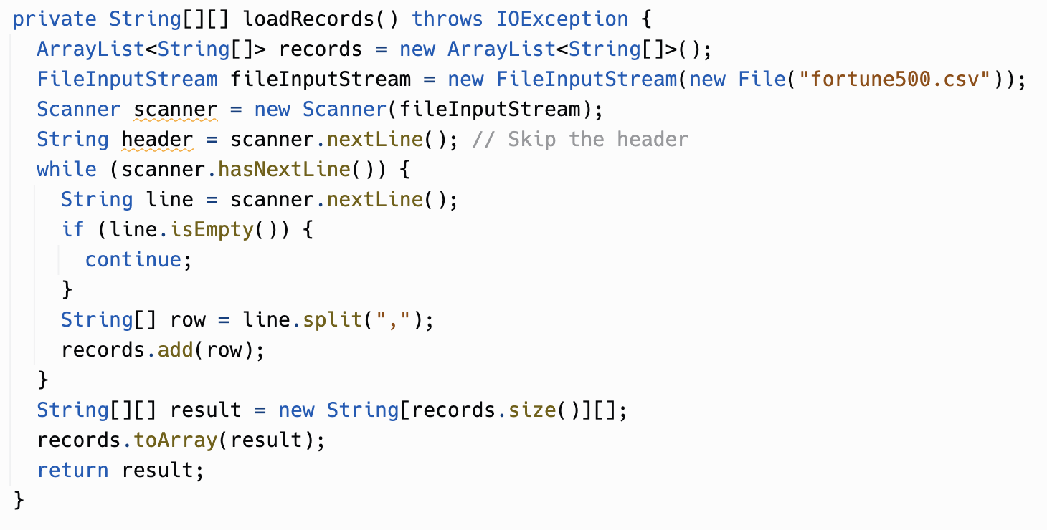
InsertionSort exercise with 2D arrays
In the InsertionSort exercise, we used a Record class to represent each row of CSV data.
An alternative representation would be a 2D array: the outer array is the rows of data, and each row is an inner array with the columns.
Why? Sometimes you don't need to be able to look up columns easily by name, such as if you're just formatting it.
Could this result in a jagged array?

Slide 39
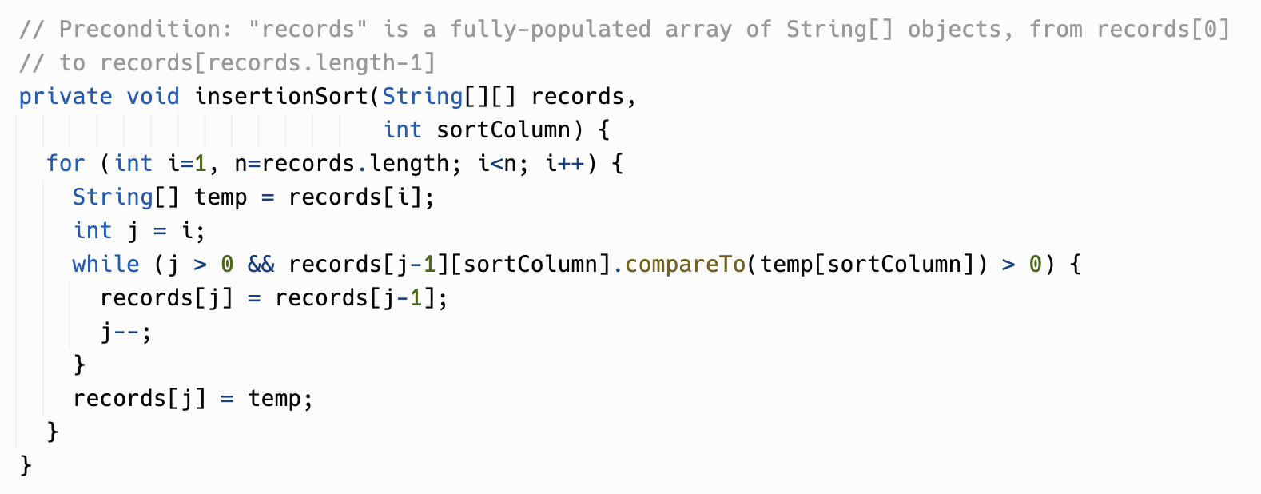
InsertionSort exercise with 2D arrays
The inner arrays in a multi-dimensional array in Java are just objects. You can do anything with them that you'd do with any object in an array, including reassign them and move them around.
Here, we're insertion sorting a 2D array, by rearranging the inner arrays.

Slide 40
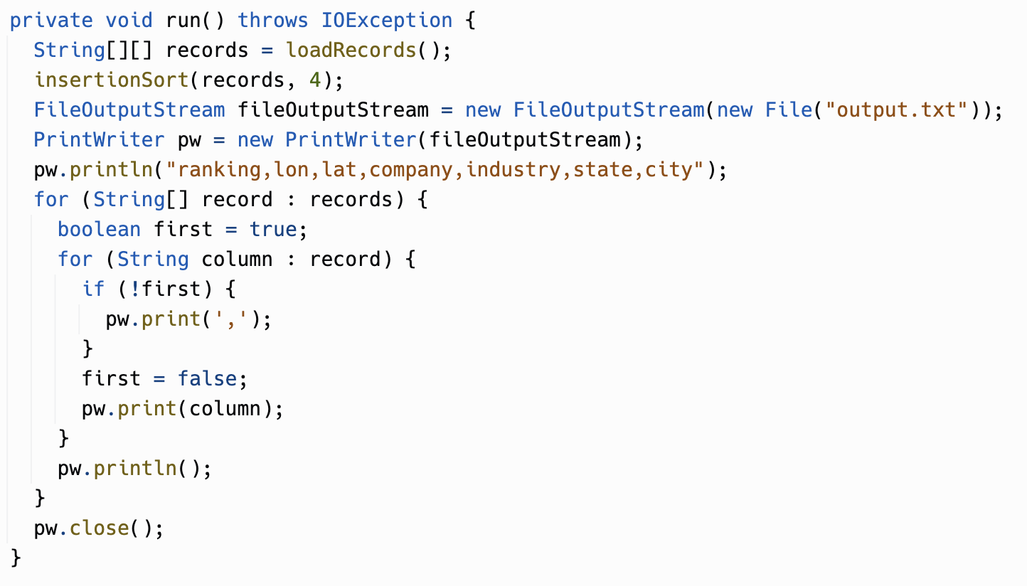
InsertionSort exercise with 2D arrays
Here, we're outputting the sorted results to a file.
The for-each iteration over the outer array came in handy here, as well as for the inner array.
This could've been expressed with regular for loops with i and j variables, but this is nice and clean.

Slide 41
Back to Battleship – Hints from Chris, one update
#2: Using Player.getDamageReport() is not going to get you want you need; It does not display ship positions
#4: For folks writing ship placement code - If you want to save some time check out Ship.placeShip() and Grid.isLegal()
#5-6: Your AI - Player.selectTarget() - SHOULD NOT be accessing Cell.getShip() - restrict your usage to Cell.isFiredOn(), Cell.isHit(), and Cell.isMiss()
UPDATE from Gary: It is OK to call Cell.getShip(), since you are told when you get a hit which ship it is, e.g. Tom: "D-4." Frank: "Hit. Destroyer." But don't look at the locations array in Ship because that would be cheating! The AI can know which ship was hit, but not where it is other than where it's already landed hits.

Slide 42
Battleship - One more targeting idea
The instructions for the project outline a "Basic" and "Advanced" algorithm. The Basic algorithm is fine to implement.
A middle ground:
Find a cell that has a hit and the ship isn't sunk yet.
If there is an adjacent cell with a hit on the same ship, and the opposite direction hasn't been fired on yet, fire in that opposite direction.
Otherwise fire on any adjacent cell. If none left, resume loop.
This will still fire at more spots than strictly necessary but will sink ships faster than the "Basic" algorithm.

Slide 43
For the rest of the period...
Continue work on Unit 8 Project
CS Awesome, study for Unit 8 Test

